Slide 1
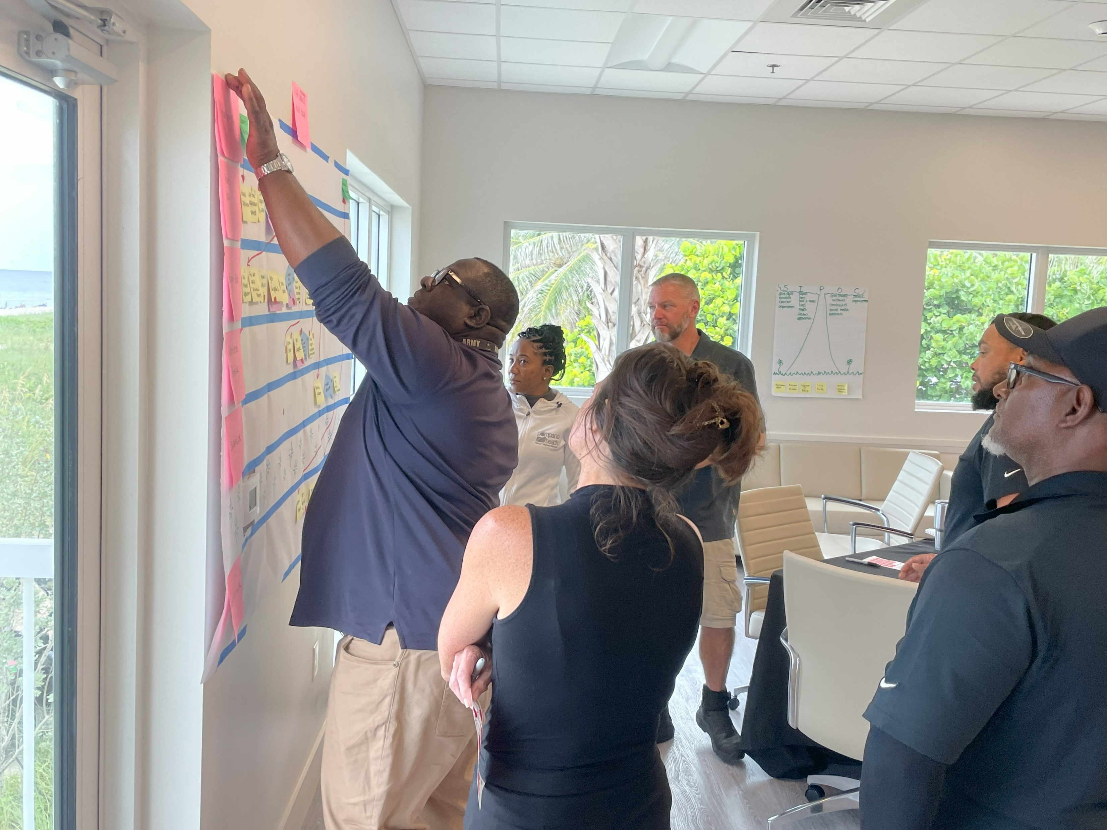

Shaping Culture with Process Improvement and Innovation Training
FCCMA Annual Conference
May 30, 2025

Slide 2

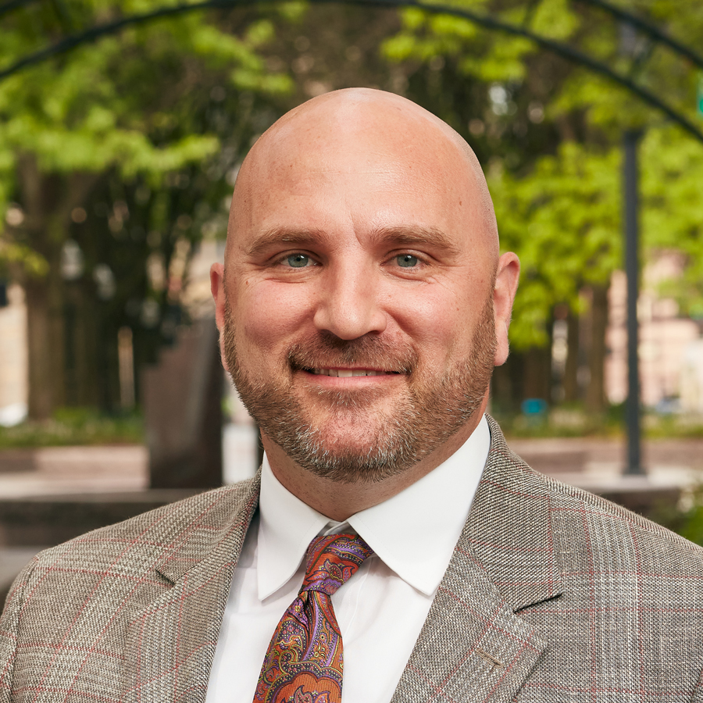
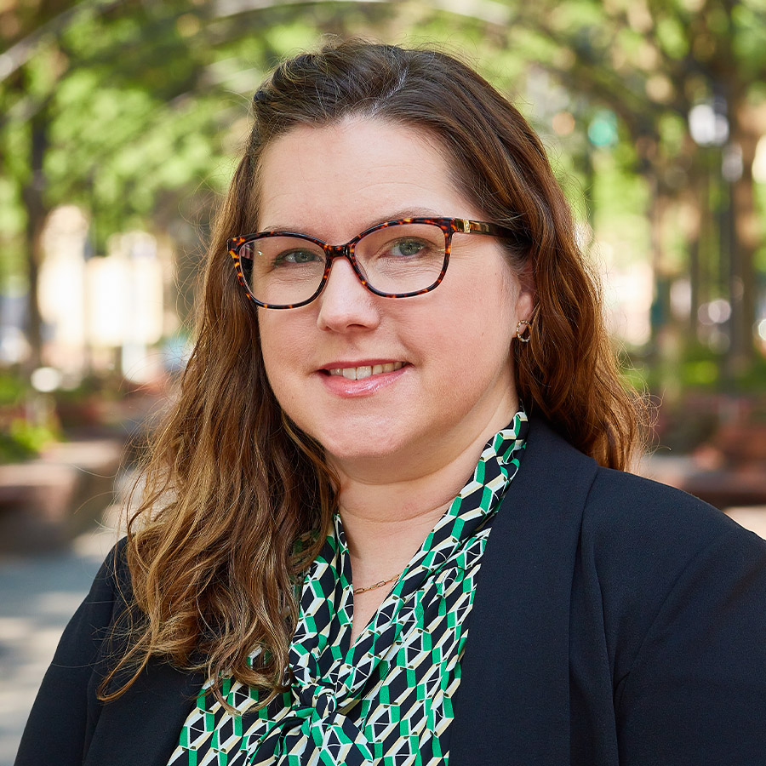
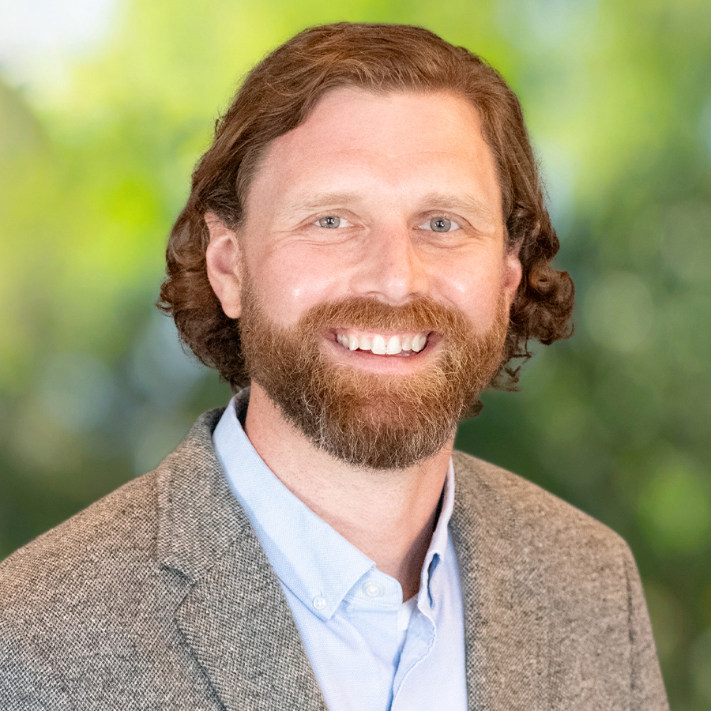
Speakers
Randy Brown
Utilities Director (City of Pompano Beach)
Jonathan Ingram
Vice President (Raftelis)
Jennifer Teal
Senior Manager (Raftelis)
Ben Kittelson
Manager (Raftelis)
2

Slide 3
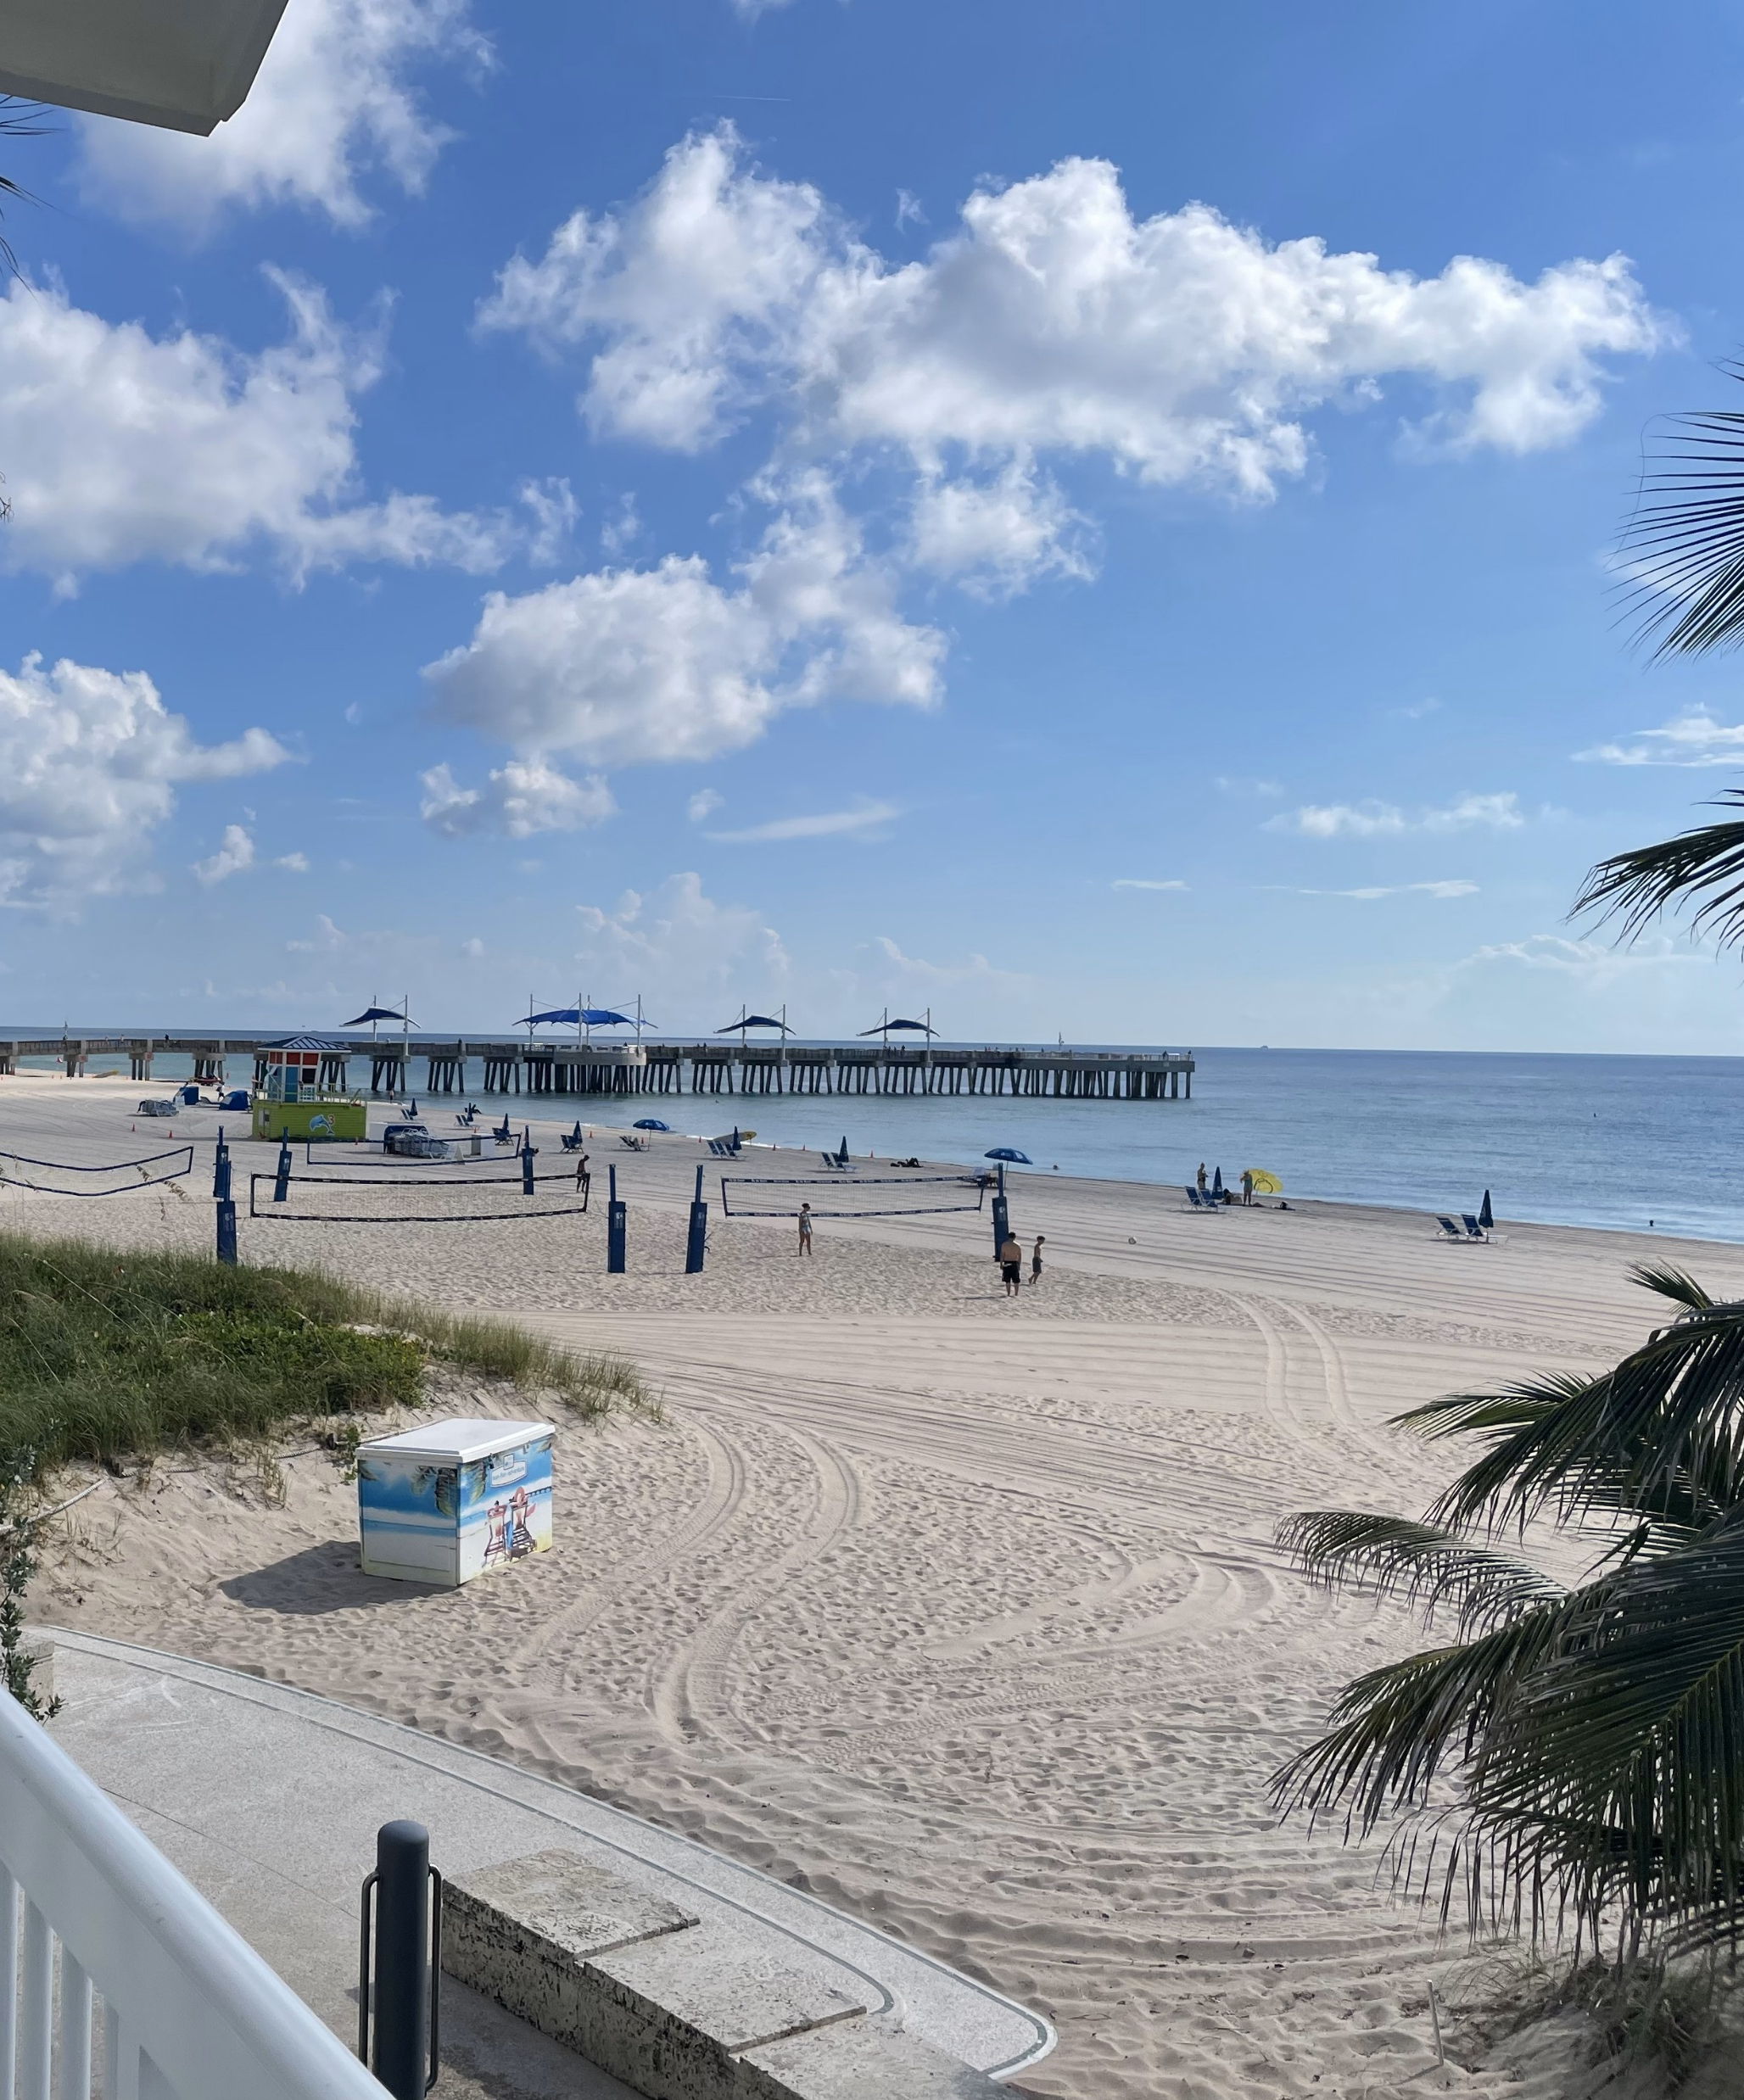
Session Goals
Understand the importance of process improvement and innovation in local government
Highlight municipal success with process improvement and innovation training
Learn to spot waste in your own organization through the DOWNTIME tool

Slide 4
Why Process Improvement Matters

Slide 5
When you know your “why,” your “what” becomes more clear and more impactful.
Comedian Michael Jr.
Notes:
When an organization is in touch with its “why” it can be amazing to work with
When individual employees are too, and the “why” is shared, it’s magical
Finding your “why” motivates you and gives you purpose
Your “why” helps in decision-making. It helps point you to true-north.
It sustains us when things are tough – remembering our “why” can be what gets us through hard times.
When you know your “why” your “what” becomes more clear and more impactful.”
-comedian Michael Jr.

Slide 6
Why Process Improvement? Why Now?
Enduring Value of Process Improvement:
Ensure value and equity for residents and customers
Identify solutions for budget challenges
Leverage existing technology
Invest in the people who do the work
Produce measurable results
Emerging Challenges and Opportunities:
Quick turnarounds become the norm
Openness to ideas that were previously “impossible”
Willingness to pilot or prototype solutions
Highlighting previously unaddressed inefficiencies and inequities
Notes:
Talk about why Process Improvement is important all the time – since we work in service of the public, its important that we make sure our processes and efforts serve them effectively.
Beyond this, the pandemic and other changes in the workforce and workplace have raised our awareness of the areas where change is needed – and it has changed how we, as public servants, think about change. We have seen that quick change is possible – and that some otherwise sacred cows may not actually be sacred.
GROUP DISCUSSION:
How did the COVID-19 pandemic, budget constraints, and other emerging trends in the past several years spur change in your work areas? What were you able to change quickly?

Slide 7



Waste is Disrespectful
Waste is disrespectful of the ENVIRONMENT because it squanders scarce resources
Waste is disrespectful to our RESIDENTS because it asks them to accept and pay for processes that they don’t value
Waste is disrespectful to our STAFF because it asks them to do work that does not have value
7
Notes:
Fundamentally we understand that each of those types of waste is problematic – but at a deeper level it is important for us to think about waste in the context of our roles as public servants.

Slide 8
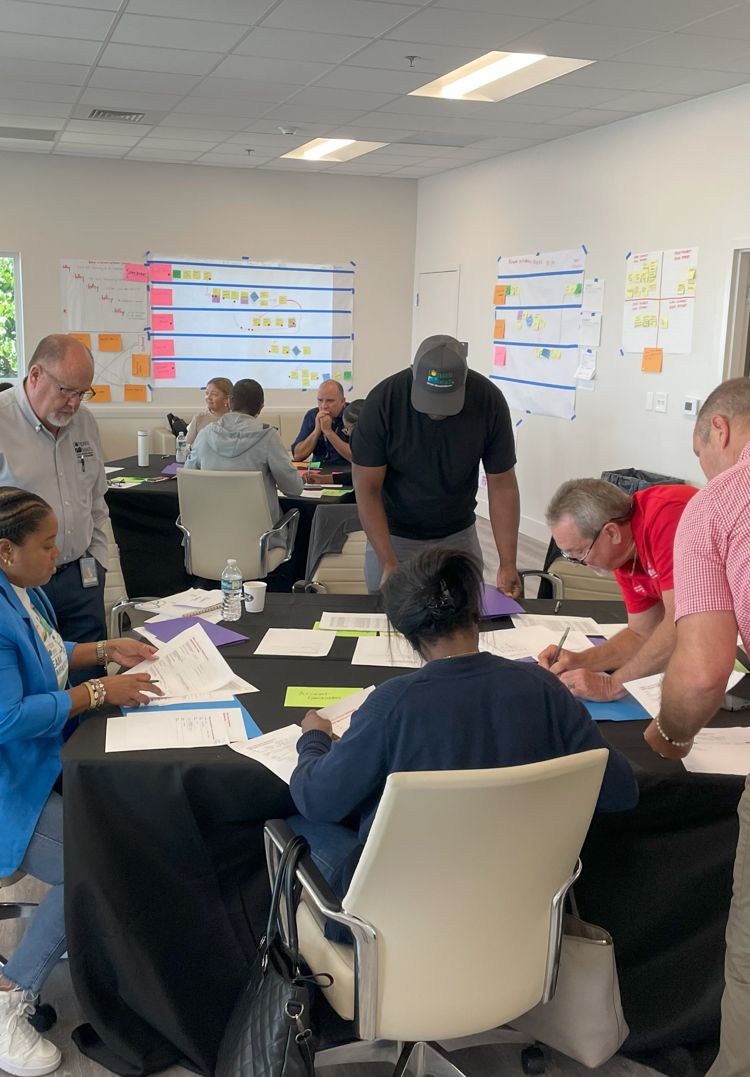
What’s Your Why?
Small-Group Discussion
Introduce yourselves to your small group and answer the following questions:
What do you love about working for your local government organization?
Why do you think Process Improvement & Innovation is important for your organization right now?
Notes:
Now let’s take a minute to talk about your “why.” We’ll break into small groups (table); discuss these questions for 10 minutes.

Slide 9
The Pompano Beach Story

Slide 10
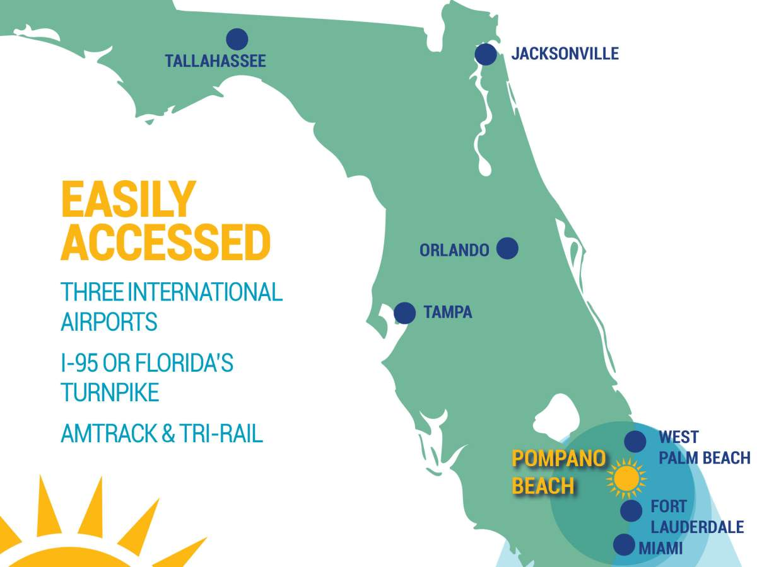
About Pompano Beach
Incorporated in 1908
Year-round population - 101,400
Seasonal influx of 50,000 part-time residents
FY2025
918 employees
All Funds budget - $497M
General Fund - $223M
Notes:
About Pompano Beach
Centrally located in the heart of Florida’s Gold Coast, Pompano Beach is positioned midway between Miami and Palm Beach and covers over 25 square miles in northern Broward County. It’s known for its beaches, boating, marinas and offshore coral reef, plus numerous wrecks and other dive sites. Anglers and families flock to the beautifully redeveloped beachside fishing village with a 1,000-foot-long fishing pier, world class restaurants, retail, playgrounds, grills and picnic tables. The warmer waters make for an abundance of pompano, the inshore tropical game fish from which the City gets its name. North, along the shore, the 1900’s Hillsboro Lighthouse guards the Hillsboro Inlet, an entrance to the Intracoastal Waterway.
The City has over 101,400 residents which increases to over 150,000 during the season, when part-time residents return for the warm, sunny weather. Located near two international airports, several international seaports, railways and highways, Pompano Beach provides access to the global marketplace. Being part of Broward County also gives us the added advantage of being close to over two million people and 50,000 businesses while maintaining our history, charm and promise of being “Florida’s Warmest Welcome”.

Slide 11
The Pompano Beach Innovation Journey
2024
Citywide Process Improvement and Innovation Training Program Launched
2021
COVID-19 Temporarily Puts the Kibosh on the Program!
Today!
2015
City-wide Lean Six Sigma Program Launched
2021
Sterling Explorer Assessment
2011
Pompano Beach Joins Florida Benchmarking Consortium
2009
Utilities Department Performs an EUM Assessment
2013
Utilities Department Adopts Lean Six Sigma
Notes:
Additional context:
Note change in leadership – 2017, new city manager
2020 – COVID – Citywide six sigma program fizzles due to emerging priorities and lots of employee turnover
Utilities staff continues as the constant – keeps doing quality/LSS even as # of trained employees drops –
Time for a fresh infusion of training in the org –
Initially planned for training for just utilities, desire to open it up to folks from across the city
Partnered with Raftelis bc of trusted partner relationship with utilities department
Today – folks have a renewed energy and focus on process improvement throughout the city – What examples can you share?

Slide 12
Widescale Participation
Building Maintenance
Public Works Administration
Engineering
Code Enforcement
Recreation Activities
Environmental Services
Aquatics
Budget
Utilities
Grounds Maintenance
Streets
Building Inspection
Development Services
City Manager’s Office
Finance/Treasury
Housing and Urban Improvement
24 staff from 16 City departments participated in the most recent Process Improvement and Innovation training program in August 2024

Slide 13
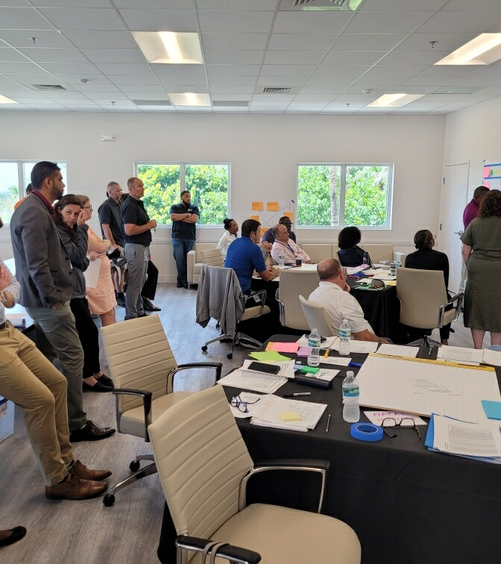
Benefits of Process Improvement and Innovation Training
Renewed Energy
Enhanced Collaboration
Increased Efficiency
Employee Empowerment
Improved Communication
Sustainable Growth
Notes:
Renewed Energy and Excitement: Staff members are more enthusiastic about trying new ideas and improving processes, leading to a more dynamic and innovative work environment.
Enhanced Collaboration: The training has facilitated connection building among staff from different departments who wouldn't have otherwise known one another, fostering a more cohesive and collaborative organizational culture.
Increased Efficiency: By learning and implementing process improvement techniques, employees can streamline workflows, reduce waste, and enhance overall productivity.
Employee Empowerment: Staff feel more empowered to contribute ideas and take initiative in problem-solving, leading to a greater sense of ownership and job satisfaction.
Improved Communication: The training encourages open communication and knowledge sharing across the organization, breaking down silos and promoting a more transparent work environment.
Sustainable Growth: With a focus on continuous improvement and innovation, the organization is better positioned to adapt to changes and sustain long-term growth.

Slide 14
Key Concepts in Process Improvement

Slide 15
If I had an hour to solve a problem, I’d spend 55 minutes thinking about the problem and 5 minutes thinking about solutions.
-Attributed to Albert Einstein

Slide 16
Visualizing and Analyzing a Process
Many of our business processes are invisible
Process participants only see their portion of the process
They often occur inside one or more computer systems with limited visibility
1
To understand the current state, we need to visualize the process
2
Once we can see the process in its entirety, we can analyze it
What are the steps in the process that create waste?
What are the steps in the process that add value?
3

Slide 17
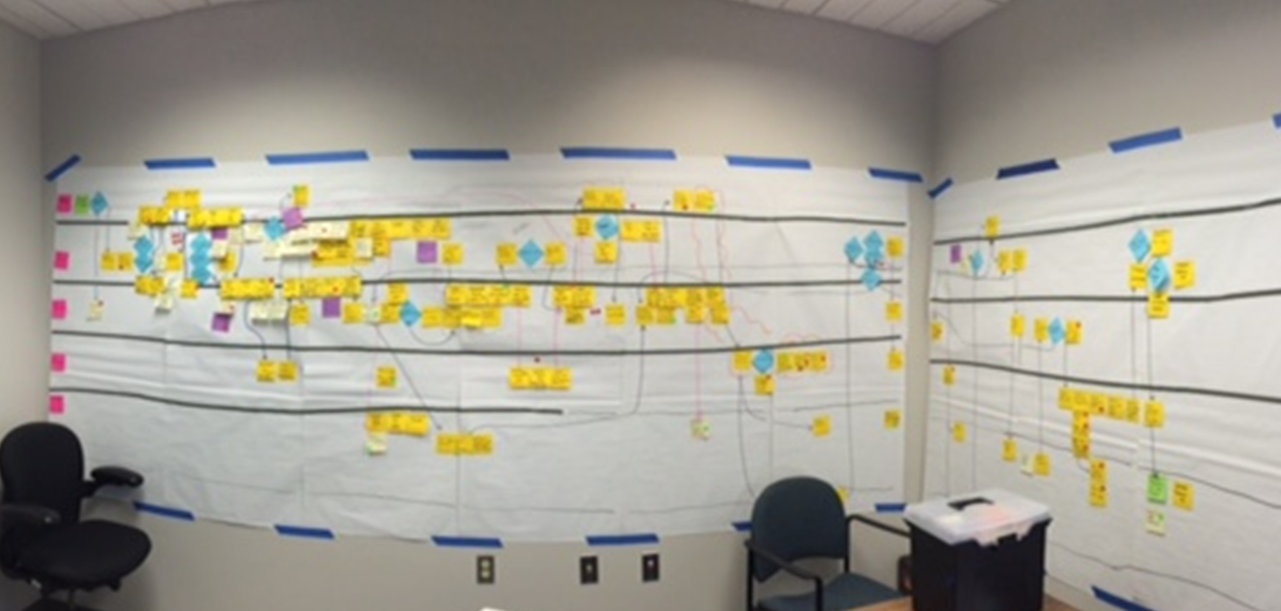
Process Maps
Process Maps are diagrams that visually display a series of steps, decisions, and handoffs that occur within a given business process. Once we can see the process, we can analyze it.
Notes:
Process Maps are diagrams that visually display a series of steps and decisions that occur within a given process.
There are many ways to create process maps – and none of them are wrong!
In this course, we will practice a hands-on sticky note intensive method of process mapping called a swim lane diagram
Process Maps are used to:
•Visualize the current flow of a business process
•Identify the responsibility and tasks completed by different business functions
•Identify handoffs between functions
•Facilitate the identification of wastes (DOWNTIME), value-added, and non-value-added activities

Slide 18
Eight Wastes - look for the DOWNTIME
D
O
W
N
Defects
Over-Production
Waiting
Non-Utilized Talent or Resources
T
I
M
E
Transportation
Inventory
Motion
Extra Processing
Notes:
Show that these write out “DOWNTIME” –
Write each word on a piece of chart paper (new word/phrase on each line, underline the first letters… this will hang throughout the course)
On our process maps we will eventually put a red sticky dot on each place where we think there is waste – and write the first initial of the type of waste
Don’t spend too much time on this slide – lots of detail on the next 9

Slide 19
Identifying Waste
Defects
Efforts caused by rework, scrap, or incorrect information
Process requires returns, rework, or repair
Examples:
Incorrect tax or benefit calculations
Equipment malfunction due to parts installed incorrectly
Errors in recording data - like Personnel Action Forms
Faulty software implementation
Overproduction
Producing more than is needed or before it is needed
Entering the same information in multiple places
Examples:
Maintaining multiple files and databases with similar information
Printing more copies of forms than are required
Assigning more staff than needed for a public event
Notes:
Talk through each of the 8 wastes – as you go through this and the next 3 slides. Ask for additional examples that folks may have. Note: For each type of waste, we’ve identified one example that relates back to the coffee example being used throughout class and at least one other that relates to a process like we see in our work

Slide 20
Identifying Waste
Waiting
Wasted time waiting for the next step in a process
Dependency on others to complete tasks
Examples:
Delays in development approvals due to planning commission meeting cycle
Idle time during equipment breakdowns
Maintenance requests wait in the queue because the right parts not on site
Time spent waiting for multiple approvals
Non-Utilized Talent or Resources
Underutilizing staff talents, skills, and knowledge
Not using tech resources that we already have
Examples:
Capable & available staff not being used as surge support
Limited training opportunities can prevent staff from reaching their full potential
Modules in existing IT systems not being activated or used to their full advantage

Slide 21
Identifying Waste
Transportation
Unnecessary movement of products and materials
Multiple handoffs
Examples:
Transporting documents between offices
Supplies are sent to a central receiving facility before being distributed to the ordering department
Inefficient routing for waste collection
Inventory
Excess products and materials not being used
Holding on to things “just in case”
Examples:
Storing surplus supplies, equipment, parts, or materials
Excessive promotional materials
Keeping specialty equipment that is rarely used
Notes:
Unnecessary movement of PEOPLE is called Motion waste --- this is related to the widgets moving through the system
How is Inventory Waste different than Overproduction?
Overproduction is when we create more of a product than is needed to meet demand – sometimes we do this when there is an economy of scale and we’re certain we’ll use it all up
Inventory is when we hold on to excess raw materials, work-in-progress , or spare parts without immediate use. Often related to scarcity mindset and challenges with disposing of public property.

Slide 22
Identifying Waste
Motion
Unnecessary movements by people
Inefficient workplace design
Searching for work documents of supplies
Examples:
Making several trips to retrieve documents
Returning to the shop to get the right tools for a repair
Excessive Processing
More work or higher quality work than is required
Too many reviews/approvals
Examples:
Redundant data entry
The city manager approving every personnel action form
Sending every request through legal review “just in case”
Notes:
Unnecessary movements of products or materials is TRANSPORTATION

Slide 23



Investigating Value
Customer Value
In order to be able to deliver what customers value and do it well, we investigate what adds value in a process.
Public Value
No Value Added (NVA)
Notes:
(On our process maps, we use a gold star for items that have a value to the customer, silver stars that have a public value and red sticky dots with NVA to show no value added)

Slide 24
Identifying What Customers Value
Customer Value
Customer Value activities transform information into services and products that meets the customer’s needs.
In other words, anything that the customer asks for and/or is willing to pay for.
Customer Value Examples
Receiving a drivers’ license
Having utility services turned on
Receiving an occupancy permit
Getting permission to hold an event
Notes:
Customer value is what the customer is “asking” for when they engage in the process – if I order a coffee, what do I value? The process step where I receive my coffee is the primary value for me – most everything else (the business process it takes to create the coffee) may be irrelevant to me. What else might I value?
Writing my name on the cup – so I know which one is mine, or can differentiate between multiple drinks I ordered
Putting a lid on the cup – so I don’t spill on myself
Putting the little sleeve on the cup – so I don’t burn my fingers
If I’m putting in a work order request, what do I value?
Most obviously – getting the repair completed
Less obvious – getting an email that tells me my work order was received, receiving status updates, letting me know my case was closed…

Slide 25
Identifying Public Value
Public Value
Public Value activities are steps or actions that must be completed for legal or regulatory reasons, although there may be opportunities to complete them more effectively.
Public Value Examples
Building safety standards
Formal bidding requirements
Requirements for Council or Board approval for contracts over a threshold
Notes:
When we talk about Public Value, we’re talking about those things that differentiate our public sector work from the private sector – specifically, what are those activities or tasks that are part of a process that the customer may not ask for, but other stakeholders value?
We shouldn’t assume that activities with a public value must continue just like they do – if they create delays or other waste, there may be an opportunity to innovate – while still maintaining the public value that the activity creates.

Slide 26
DOWNTIME Scavenger Hunt

Slide 27
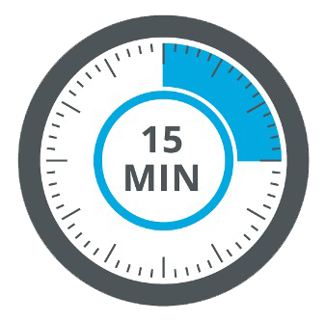
Scavenger Hunt Round 1
Appoint a spokesperson
Read and discuss your assigned scenario
Identify where there is customer or public value in the process
What types of DOWTIME do you see?
What about this scenario is familiar to you?
If you see similar issues in your organization, what have you done to address them?

Slide 28
Scavenger Hunt Round 2
Appoint a spokesperson
Read and discuss your assigned scenario
Identify where there is customer or public value in the process
What types of DOWTIME do you see?
What about this scenario is familiar to you?
If you see similar issues in your organization, what have you done to address them?

Slide 29
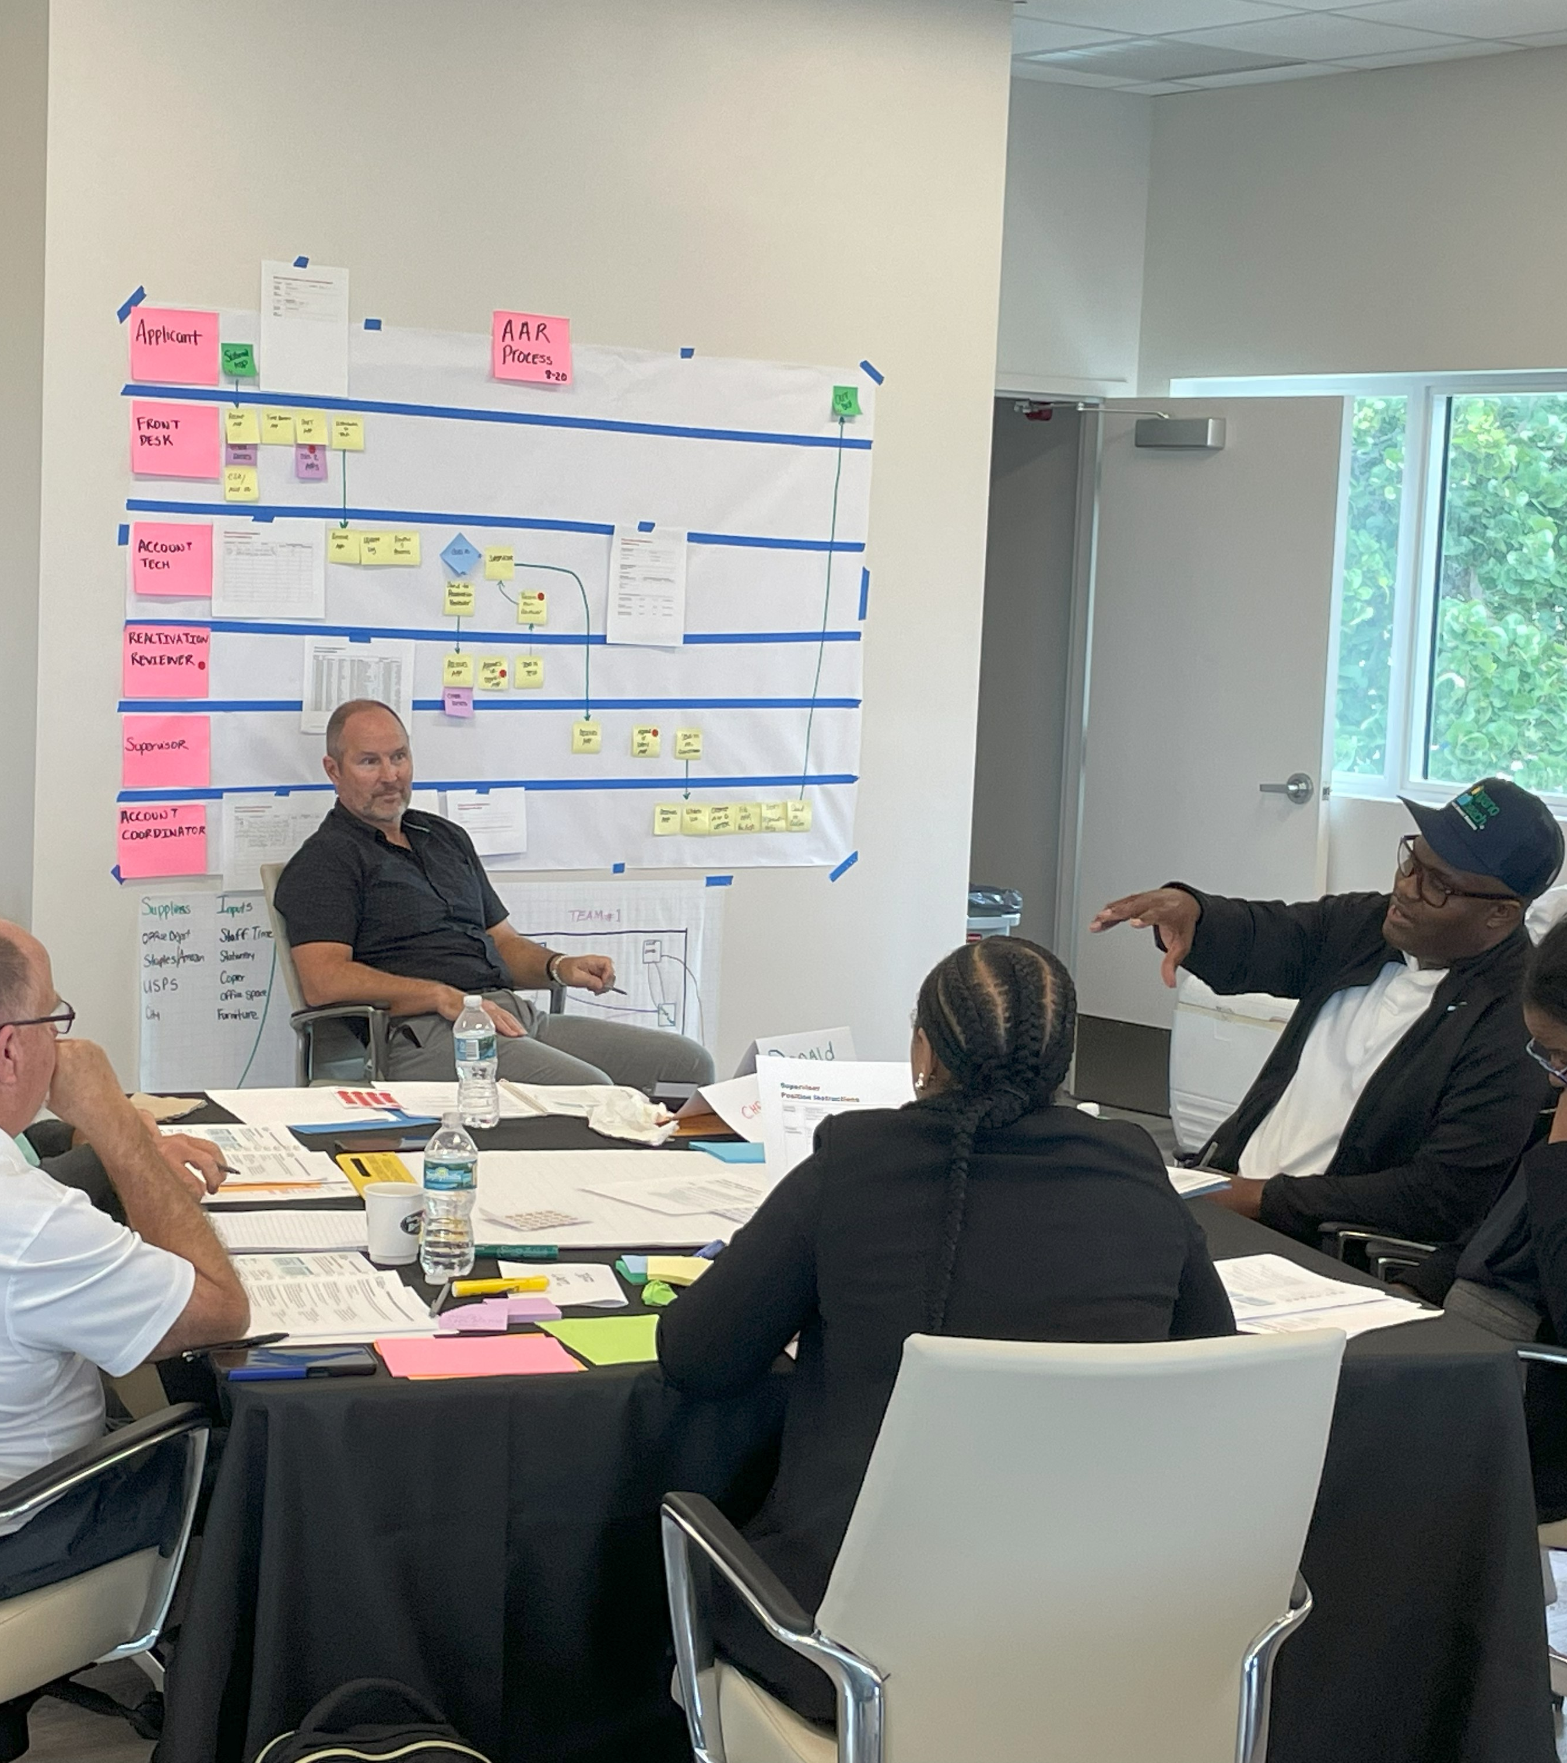
Debrief
What types of waste were most prevalent?
What was surprising?
Could this exercise work in your organization?

Slide 30
Wrap Up

Slide 31
Questions &
Takeaways

Slide 32

Thank you!
Contact:
Randolph Brown / Randolph.brown@copbfl.com
Jonathan Ingram / jingram@raftelis.com
Jennifer Teal / jteal@raftelis.com

